Slide 1
Game theory and naturalized justice
Miłosz Ślepowroński

Slide 2
Some background
1954 - R. Braithwaite,Theory of Games as a Tool for the Moral Philosopher
1969 – D. Lewis, Convention
1986 – D. Gauthier, Morals by Agreement; R. Sugden, The economics of rights, co-operation, and welfare; J. Hampton, Hobbes and the Social Contract Tradition; G. Kavka, Hobbesian Moral and Political Theory
1996 – K. Binmore, Game Theory and the Social Contract; 2006 – Natural Justice

Slide 3
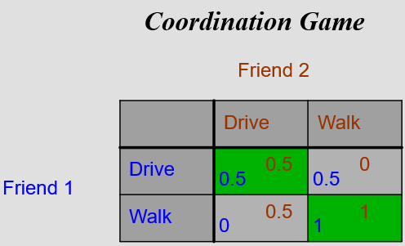
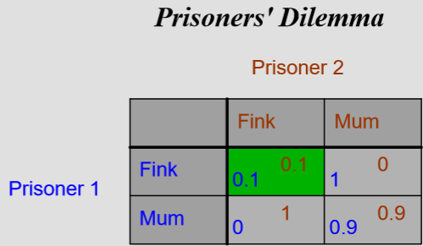
Equilibria in games

Slide 4
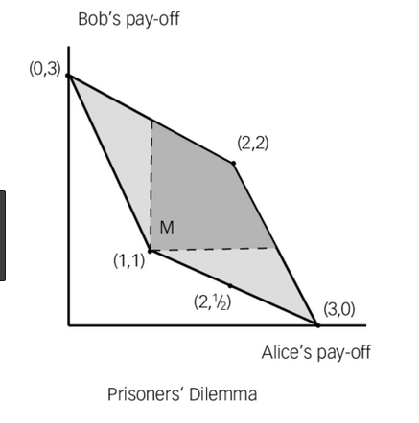
Folk theorem

Slide 5
Some problems
Neither purely descriptive nor normative
Weak empirical grounding
Excessively abstract
Ultimate vs proximate causation
Coalitions

